Slide 1


The Skeletal System Movement Analysis
&
Energy Systems
Transition Work

Slide 2
Sport and PE Transition Tasks
In preparation for your forthcoming study, the following tasks will require you to investigate the structure of skeletal and muscular systems and the energy systems used in sport and physical activity.
***Please make a copy of this slides booklet and fill in***
Websites that may help are:
www.brianmac.co.uk
https://www.google.co.uk/url?sa=t&rct=j&q=&esrc=s&source=web&cd=&ved=2ahUKEwjo2faJmeT_AhUJS8AKHcUaAmgQFnoECA0QAQ&url=https%3A%2F%2Fwww.ocr.org.uk%2FImages%2F563078-1.1.c.-energy-for-exercise.pptx&usg=AOvVaw0l8hQ1pYCHk8BqLPMoaBp_&opi=89978449

Slide 3
Sport and PE Transition Task 1 - skeletal system
Skeletal system
Search for a blank skeleton or draw your own and label the major bones in the body -
Extension - try and identify the different types of bones - flat bone, long bone, short and irregular bones.

Slide 4
Skeleton
In the box opposite insert your skeleton and label or upload your finished labelled skeleton.

Slide 5
Sport and PE Transition Task 2 - muscular system
On the following slides you will find a series of movement analysis slides that you need to complete.
For each slide you should give the type of joint, the movement occurring, the main muscles being used and insert a picture for this type of joint.
The types of synovial joint are:
• hinge, i.e. elbow, knee, ankle
• ball and socket, i.e. shoulder, hip
• pivot, i.e. neck, radio-ulnar
• condyloid, i.e. wrist
• saddle, i.e. thumb
• gliding, i.e. processes of the vertebra
Joint movements are
• flexion and extension
• lateral flexion
• abduction and adduction
• horizontal abduction and adduction
• medial and lateral rotation
• circumduction
• pronation and supination
• dorsiflexion and plantar flexion
AGONIST – the muscle responsible for creating movement at a joint. ANTAGONIST – the muscle that opposes the agonist providing a resistance for coordinated movement.

Slide 6
Shoulder
Joint Type | Movement | Agonist | Antagonist
Insert sporting movement

Slide 7
Elbow
Joint Type | Movement | Agonist | Antagonist
Insert sporting movement

Slide 8
Wrist
Joint Type | Movement | Agonist | Antagonist
Insert sporting movement

Slide 9
Hip
Joint Type | Movement | Agonist | Antagonist
Insert sporting movement

Slide 10
Knee
Joint Type | Movement | Agonist | Antagonist
Insert sporting movement

Slide 11
Ankle
Joint Type | Movement | Agonist | Antagonist
Insert sporting movement

Slide 12
Sport and PE Transition Task 3 - Energy systems
For each of the systems please find out the following information and create a revision poster using pictures and diagrams.
Energy systems:
ATP-PC (Phosphocreatine) system
Lactic acid system
Aerobic system
Information
Type of reaction (aerobic or anaerobic)
Sports that predominantly use this system
Chemical or food fuel
Amount of ATP produced
By-products

Slide 13
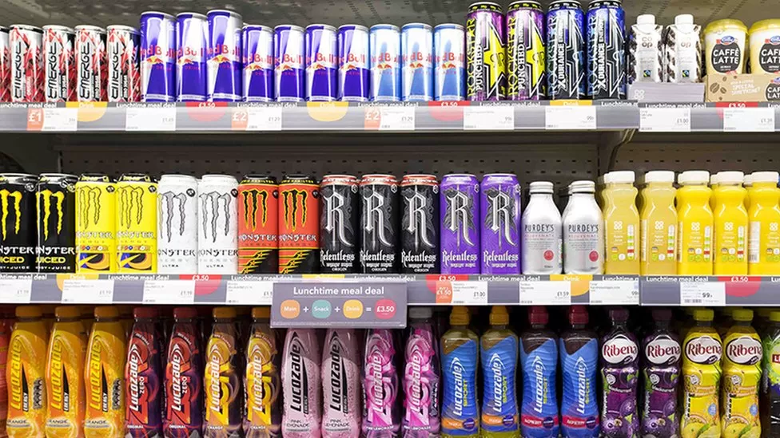
Sport *Extended Diploma*
We would like you to create your own sports drink and create a poster to promote your product. Consider the following points;
Who is your target demographic?
What sort of drink will you create?
What will the brand name be?
What will the packaging look like?
What is the price point?
How will you ensure it sells? Advertisements?

Slide 14



Any questions ?
Google Classroom
kateclark@leggott.ac.uk
joanneneal@leggott.ac.uk
jessicasharp@leggott.ac.uk
jennifergrimes@leggott.ac.uk
TeamJLCSport

Slide 15


